Slide 1
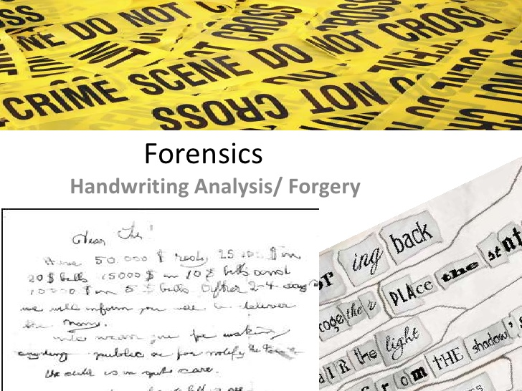

Slide 4
12 characteristics for
comparing
handwriting

Slide 15
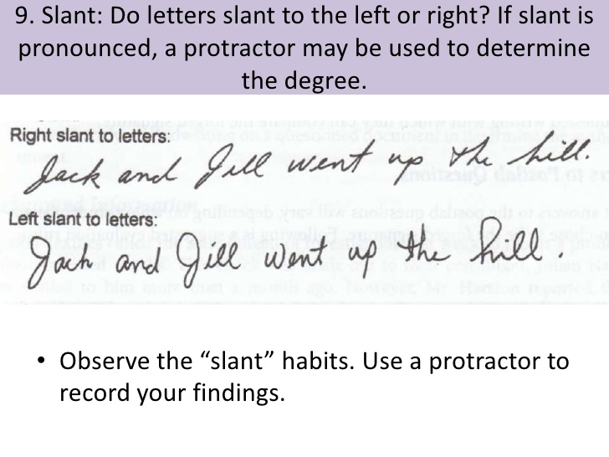

Slide 17
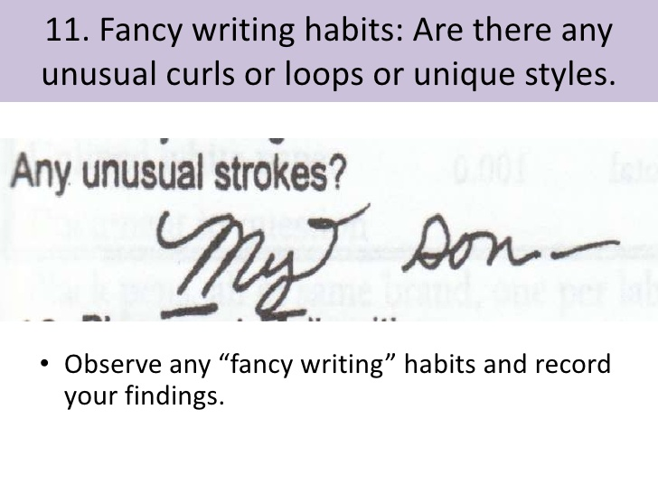

Slide 19
Forgery
Forgery: is the process of making, adapting, or imitating objects, statistics, or documents with the intent to deceive or make usually large amounts of money by selling the forged item

Slide 20
Forgery
Many times criminals will try and forge a signature on a cheque in order to steal money

Slide 21
Lets see if we have any good forger’s in our class
You will get a piece of paper with 4 rows.
Please do your signature in the space where it says one
You would then pass it to the person beside you and they would try and forge your signature. They would fold the paper (like you fold a paper fan) so it is still only the original signature showing and pass it to the next person…
Take a look and discuss your attempted forgeries

