Slide 1


Identifying shoeprints

Slide 2

Footprints…Shoe Prints
Things you can learn from shoe prints:
The type of shoes someone was wearing
The direction the person was going
Whether the person walked in an unusual way or if they were running
Can sometimes tell the person’s approximate height and weight

Slide 3
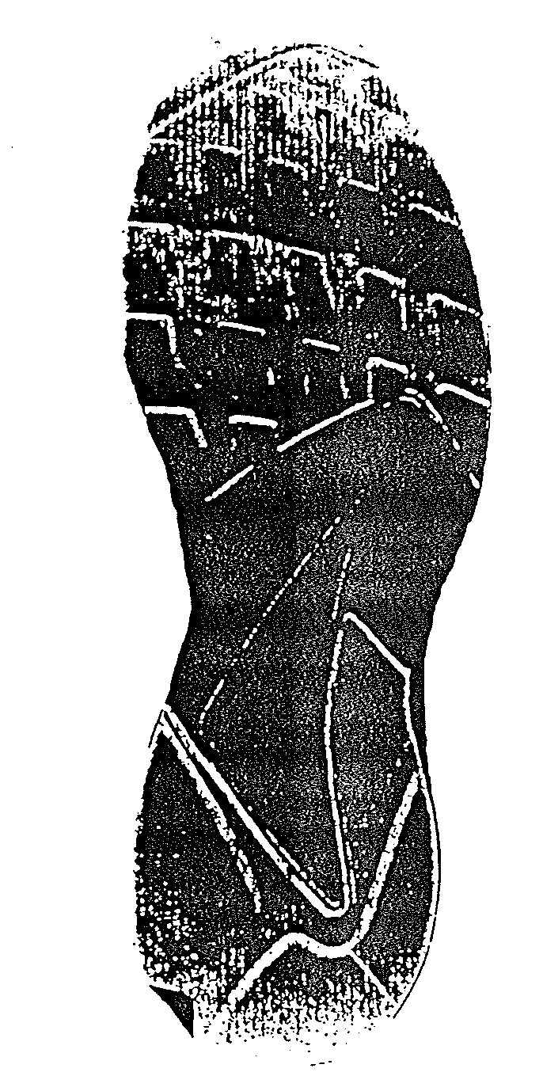
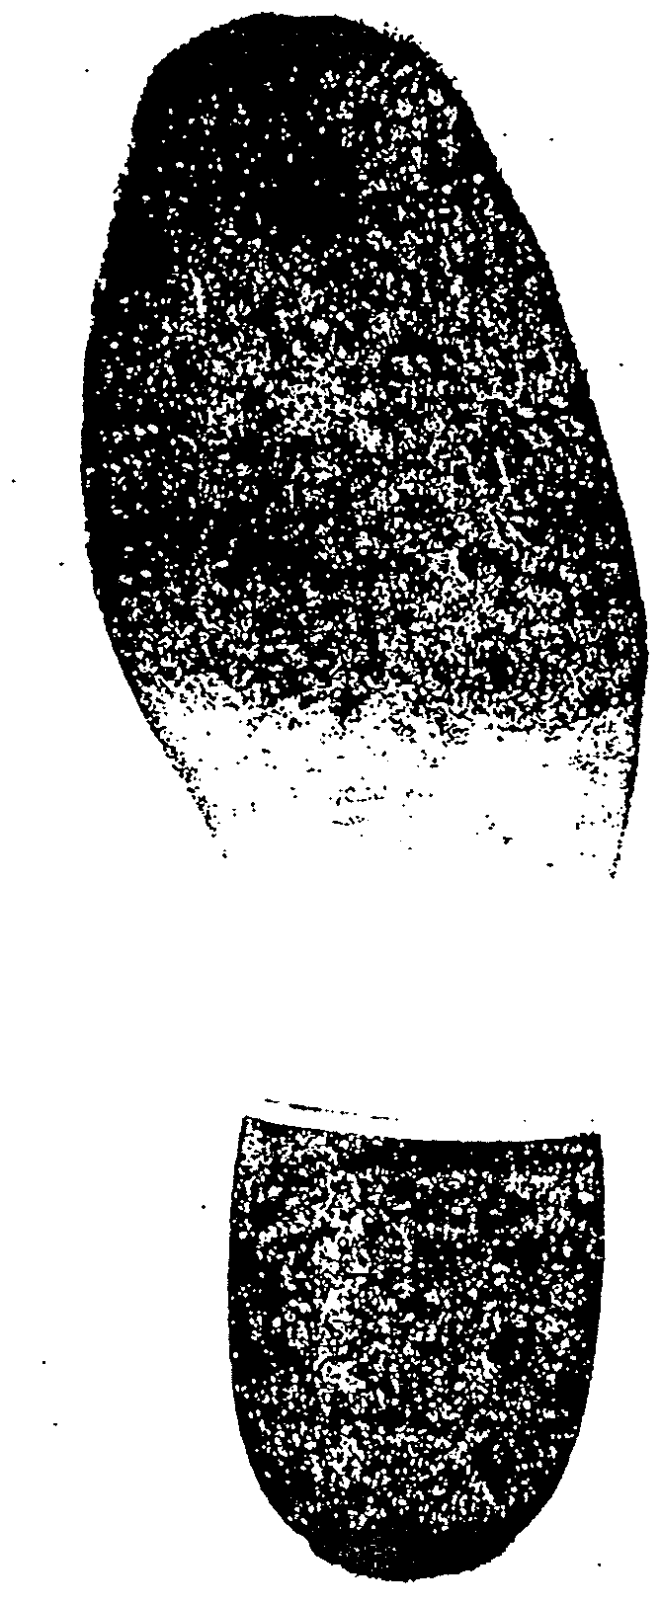
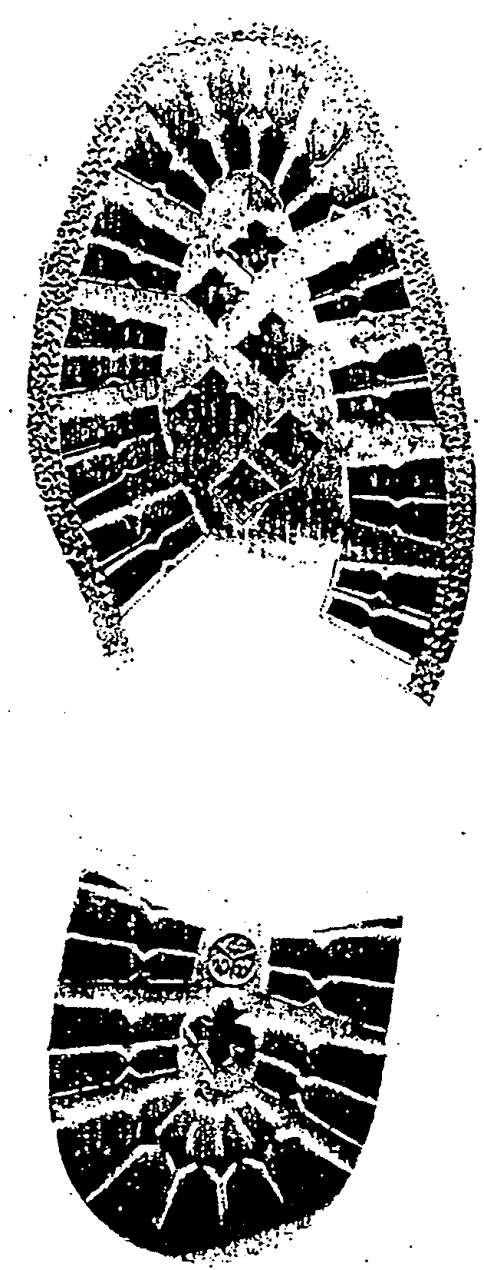
Shoe Print can be classified by…
Size
Shape
Tread pattern
Distinguishing characteristics
Cuts and marks

Slide 4
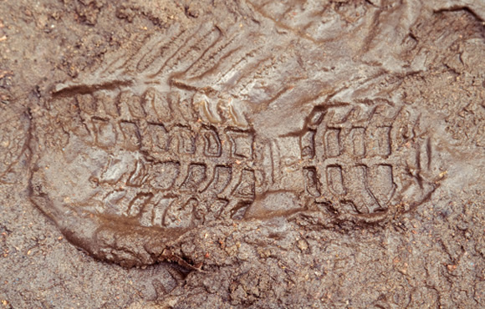
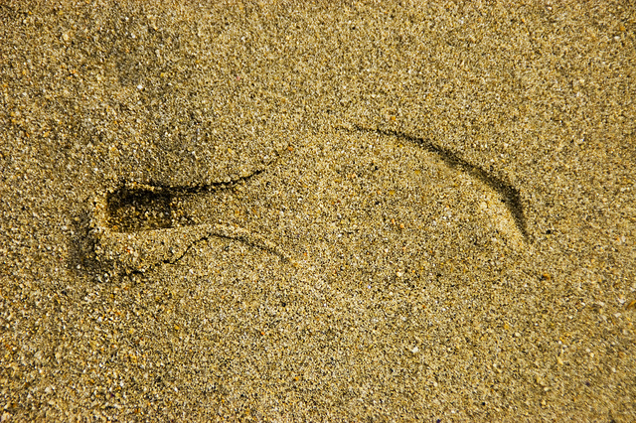
Looking at the tread
A shoe print can help investigators decide what type of shoe it was that left the print

Slide 5
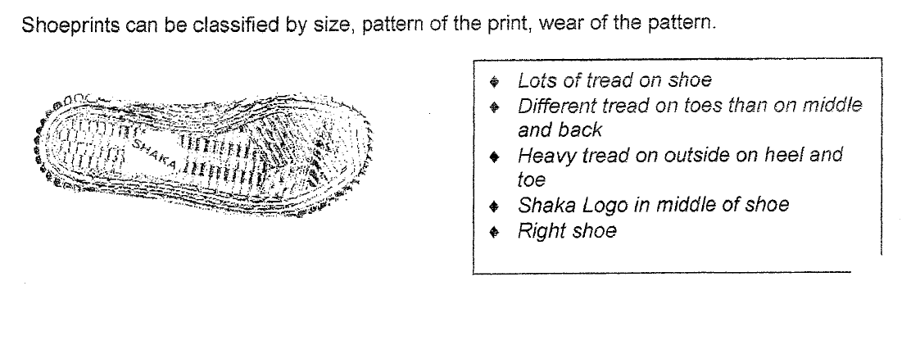
Identifying Treads

Slide 6
To do…
1. You need one shoe
2. You need a piece of white paper and a crayon
3. You need to get the tread of your shoe onto the paper
4. Use the SIDE OF THE CRAYON to get a better rubbing of the tread

Slide 7
One the same piece of paper, lets check your treads out!
1. Take both shoes off and look at the tread you just made
2. Around your rubbing record at least 6 characteristics of your shoe treads
3. If you can, try and infer about why it looks the way it does
(ex. I walk with more weight on my toes)
Characteristics of my shoe tread
1.
2.
3.
4.
5.
6.

Slide 8
What story do footprints tell?

Slide 9
Footprints…Shoe Prints
Things you can learn from shoe prints:
The type of shoes someone was wearing
The direction the person was going
Whether the person walked in an unusual way or if they were running
Can sometimes tell the person’s approximate height and weight

Slide 10
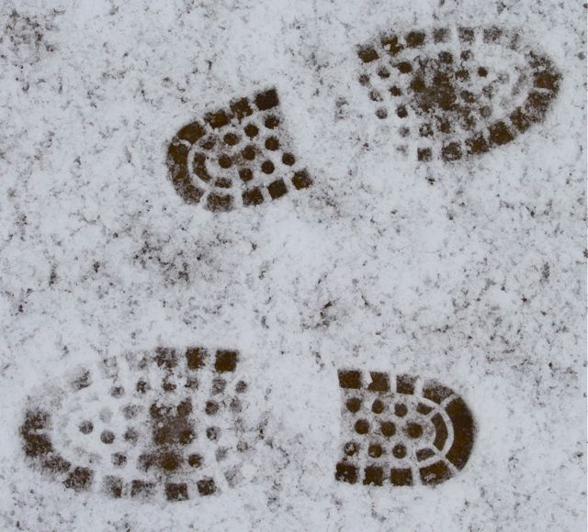
Direction
Looking at the direction of the shoeprints and the depth of the shoeprints can help investigators figure out which direction the person was going

Slide 11
Spacing in the prints
Looking at the spacing between the shoeprints can tell investigators if the person was running (large space) or walking (smaller space)

Slide 12
Evidence of Shoeprints- Running
The length of stride changes
Distribute weight over feet in a different way.
The heels of your shoe tend to go deeper into the sand, dirt, or snow when you run.

Slide 13
Walking and Running Differences
Walking
Running
What would the spaces between prints look like?
Shallower prints
Outline clearer… why would this be?
Less of a straight line (more parallel)
What would the space between prints look like?
Deeper prints
Outline may not be as clear… why?
Line of prints are straighter (not as parallel)

