Slide 1
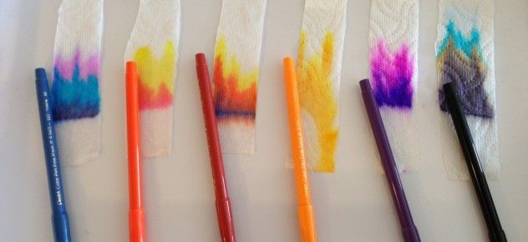

Slide 3
…SO, why would scientists need to do this?

Slide 4
Chromatography is one of the most valuable techniques biochemists have for separating mixtures.
It can be used to determine the ingredients that make up a particular flavor or scent
to analyze the components of pollutants
to find traces of drugs in urine
to separate blood proteins in various species of animals (a technique that's used to determine evolutionary relationships)

Slide 5
Talk with your group and

Slide 6
Talk with your group and

Slide 8
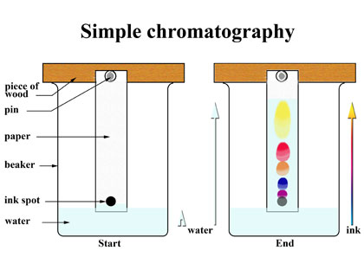
What colors do you see?
How high do the colors go after 5 minutes?
Which color went the highest?
Which color remained at the lowest point?
Were the patterns staggered?

Slide 9
Why does mixing many colors of ink make black?
Ink and paint get their colors by absorbing some of the colors in white light and reflecting others.
Green ink looks green because it reflects the green part of white light and absorbs all the other colors.
Red ink looks red because it reflects red light and absorbs all the other colors.
When you mix green, red, blue, and yellow ink, each ink that you add absorbs more light. That leaves less light to reflect to your eye. Since the mixture absorbs light of many colors and reflects very little, you end up with black.

